Slide 1
Treasury Serves You
Treasurer David H. Lillard, Jr.
Jamie Wayman, CPA, CEBS, Director of Retirement
Presentation to TCSA Post Legislative Conference
May 21, 2024

Slide 2
Local Government Investment Pool
Treasury manages state and local governments’ short-term investments through the SPIF and LGIP
Low fees
447 local governmental entities participate
62 county governments
LGIP earned $346.8 million in 10 years
Earnings for FY24 through April are $328 million

Slide 3
LGIP Earnings
March 16, 2020
Fed cut rates to
0%-.25%
March 17, 2022
Fed begins raising rates
Earnings for FY24* $328 million
* FY2024 earnings have been calculated through April 2024

Slide 4
Unclaimed Property
In FY23, we returned $68.7 million to 65,150 claimants.
From 2019-2023, we have returned nearly $1.6 million to local governments.

Slide 5
Unclaimed Property

Slide 6
Length of Service Award Program
Created to recruit, retain and reward volunteers providing firefighting and prevention services, emergency medical services, and ambulance services
State offers a matching grant of $200 per volunteer, up to $5,000 per participating entity

Slide 7
Participate in LOSAP
Local governments and other tax-exempt organizations (Eligible Employers) may elect to participate in the plan by passing the appropriate resolutions and participation agreements
The Eligible employer will pay a one-time $500 set up fee, and $250 annual maintenance fee
Employer may specify an annual contribution amount between $200 and $6000 per volunteer
State can match $200 per volunteer
Notes:
The participant fees are equal to what is charged under the State of TN 401k and 457b plans which have over $6 billion in plan assets.

Slide 8
Inaugural LOSAP Adopters
Roane County
Town of Centertown
City of Niota
Volunteer Fire Department of Seymour
Anderson County
Initial contributions of $35,000 for 76 eligible volunteers
$35,000

Slide 9
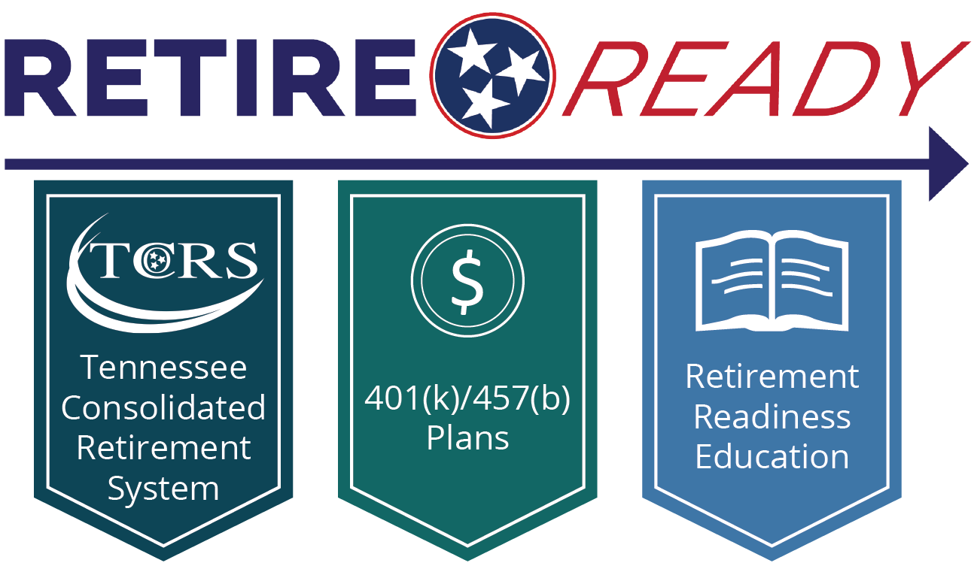
What is RetireReadyTN?
RetireReadyTN is the state's retirement program, combining the strengths of a defined benefit plan provided by the Tennessee Consolidated Retirement System, 401(k) and 457(b) plans through services provided by Empower Retirement, and retirement readiness education. We strive to empower public employees to take actionable steps toward preparing for the future.

Slide 10
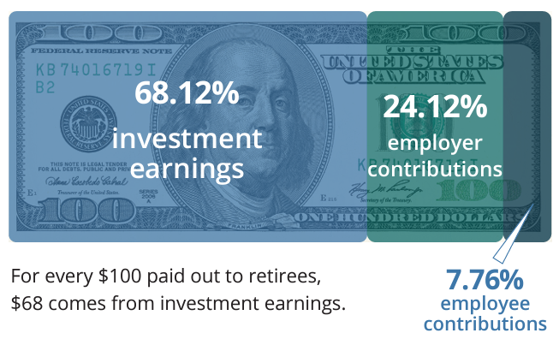
TCRS Funding and Strength
The Treasury Department protects the retirement of public employees through strong investment management and pension administration
More than $77.5 billion in investment earnings since 1972
$64.5 billion held in trust as of June 30, 2023
In fiscal year 2023, TCRS paid $3.1 billion in retirement benefits to 156,738 retirees

Slide 11
Retirement Plans for Political Subdivisions
Political Subdivisions (local governments) may elect to participate in the following TCRS plans:
Legacy
Hybrid with Cost Controls (requires DC plan component)
Hybrid without Cost Controls (requires DC plan component)
Alternate Defined Benefit
All local government entities are eligible to adopt the State of Tennessee 401(k) and 457(b) plans
Political subdivisions may customize certain TCRS and DC plan provisions

Slide 12
Political Subdivision 401(k)/457(b) Adoptions
Local Government Type | Total Adopters
Counties | 72
Municipalities | 152
Special Districts | 146
LEAs (457 adoptions) | 13
Total | 383
State of TN 401(k) and 457(b) plans typically reduce fees by 50% or more versus current vendor
Contact your regional Treasury Outreach representative for more information and to request a fee comparison
Data as of 12/31/2023

Slide 13
Hybrid Plan turns 10!
The Hybrid Plan went into effect for newly hired State and Higher Education employees and Teachers July 1, 2014
Hybrid combines TCRS, 401(k) and retirement readiness education
Stabilizes government contribution rates
Government costs are fixed at 9% of payroll

Slide 14
Hybrid Plan Participation

Slide 15
Projected Savings since 2014
Projected Savings $855,338,112.95
Projected Savings $74,142,028

Slide 16
Retirement Readiness Education
RetireReadyTN.gov
View plan features by employment type
Login to TCRS Member Self-Service and 401(k)/457(b) accounts
Access forms, guides and publications

Slide 17
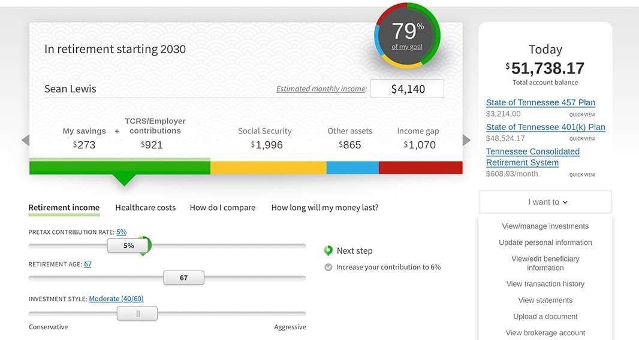
Lifetime Income Score
Log in to your 401(k) and 457(b) accounts to see your Lifetime Income Score.
A projection of your TCRS benefit is now included for all vested TCRS members.
Your Lifetime Income Score (the percentage in the circle) shows you how close you are to meeting your income replacement goal.
Notes:
Show New Experience Screenshot

Slide 18
One-on-one counseling
Retirement Readiness Reviews
Available to advise members at any stage in career
Review TCRS and defined contribution accounts, debts and outside assets
Discuss retirement goals and planned retirement age
Determine if contribution levels and investment options are in line with your goals
Perform a personalized retirement analysis and provide investment advice
Retirement Counseling
Available to advise members within three years of retirement
Determine the total income needed in retirement
Review benefit estimate and annuity options from TCRS and Social Security
Review 401(k) and 457(b) balances, investments, and distribution options
Discuss how to execute retirement plan

Slide 19
Retirement Education and Resources

Slide 20
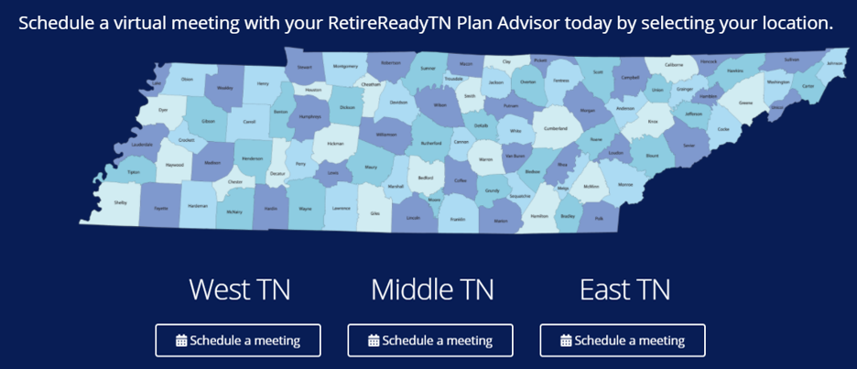
Schedule a meeting with a RetireReadyTN Plan Advisor
Retirement readiness reviews may be scheduled at RetireReadyTN.gov or by calling 800-922-7772
Retirement counseling meetings may be requested by phone and are typically scheduled approximately 60 days after your benefit estimate is ordered

Slide 22
2024 Legislative Updates

Slide 23
Return to Work
Generally, retired TCRS members are not permitted to draw retirement benefits while they are re-employed in a position covered by TCRS
A number of exceptions to this general rule are set forth in retirement law
RTW provisions typically introduced to address special employment needs or shortages.
Since 2021 there have been six (6) bills enacted by the General Assembly to expand or make changes to return-to-work programs.
Law enforcement officers (2 bills, 2021 and 2023)
Emergency medical services personnel (2022)
K-12 teachers and bus drivers (2022)
Revisions to 120-day temporary employment (2023)
School resource officers (2024)

Slide 24
Comparison of Return-to-Work Programs (No Reduction in Retirement Benefits)
 | 120-Day Temporary Employment | Limited Reemployment of Retired Teachers | Return to Work School Resource Officer
Salary Limits | Yes—60% of last salary initial year* | Yes - 85% of salary | No
Work Limits | 120 days ** | No | No
Benefit Reduction | No | No | No
Who | Any retired member | Retired Teachers | School Resource Officer
Repeal Date | No | No | June 30, 2026

Slide 25
Comparison of Return-to-Work Programs (30% Reduction in Retirement Benefits)
 | Limited Reemployment as Law Enforcement Officer | Limited Reemployment as Emergency Medical Services Personnel | Return to Work K-12 Teacher, Bus Driver, or Substitute Driver
Salary Limits | No | No | No
Work Limits | No | No | No
Benefit Reduction | Yes—70% of retirement benefit (30% reduction) | Yes—70% of retirement benefit (30% reduction) | Yes—70% of retirement benefit (30% reduction)
Who | Retired Law Enforcement Officer | Retired Emergency Medical Services Personnel | K-12 Teacher, Bus Driver, Substitute Teacher
Repeal Date | June 30, 2025 | June 30, 2025 | No

Slide 26
Return to Work Program Statistics
Program | 2020 | 2021 | 2022 | 2023 | 2024
120-Day Temporary Employment | 3,716 | 2,692 | 3,462 | 3,810 | 3,823
Limited Reemployment of Teachers | 18 | 13 | 17 | 23 | 24
Limited Reemployment of Law Enforcement Officers | -- | -- | 19 | 28 | 16
Limited Reemployment of Emergency Medical Services Personnel | -- | -- | -- | 3 | 2
K-12 Teachers | -- | -- | -- | 265 | 294
Bus Drivers | -- | -- | -- | -- | 5
School Resource Officer*
* Program begins 7/1/2025

Slide 27
Hazardous Duty Supplemental Benefit
Political subdivisions may adopt mandatory retirement provisions for its police officers, firefighters and correctional officers.
The mandatory retirement provision:
Allows a member in one of these positions to retire on service (unreduced) retirement upon attainment of age 55 with 25 years of service.
Requires someone in a covered position employed by a political subdivision that has adopted mandatory retirement to retire by age 60, unless more than 50% of their duties are administrative in nature. Those whose duties are 50% or more administrative may continue until age 62.
Provides a bridge (temporary) benefit is payable to someone subject to mandatory retirement from the latter of their date of retirement or age 55 until age 62. The bridge benefit is 0.75% multiplied by years of service and average final compensation.
Currently 30 municipalities and 11 counties have adopted mandatory retirement provisions

Slide 28
Hazardous Duty Supplemental Benefit
What is the Hazardous Duty Supplemental Benefit?
A temporary benefit payable to eligible public safety officers of a political subdivision.
No requirement to retire at a certain age
Payable from age 60 to full Social Security retirement age (67).
Three-eighths of one percent (0.375%) times AFC times years of qualifying service.

Slide 29
Hazardous Duty Supplemental Benefit
Who is Eligible?
Full-time, salaried employee of a political subdivision who is:
A sheriff, sheriff’s deputy, police officer, chief of police, or other law enforcement officer with the political subdivision whose primary responsibility is the prevention and detection of crime and apprehension of offenders.
A correctional officer.
A firefighter.
Someone meeting the criteria above must have:
at least twenty (20) years of creditable service in TCRS as a public safety officer as defined above.
Retire on either a service or early retirement benefit; those receiving disability benefits are not eligible.

Slide 30
Hazardous Duty Supplemental Benefit
Example: Member is a public safety officer who is age 60 with 25 years of service (service retirement eligible).
Employer | Service (Years)
A | 20
B | 5
Total | 25
AFC | $ 50,000.00
Hazardous Duty Supplement (HDS) Factor | 0.375%
Service to Employer adopting HDS | 20
Monthly Hazardous Duty Supplement | $ 312.50
For a member retiring on early retirement benefits, the appropriate early reduction factor will be applied to the hazardous duty supplemental benefit.

Slide 31
How to Adopt HDS
Employer must pass a resolution authorizing an actuarial study to determine the liability associated with this benefit and accept responsibility for the cost of the study.
Upon receipt of the study, the employer must pass a resolution authorizing the supplemental benefit and accepting the liability for the benefit.
The employer’s funded status must be at least seventy percent (70%) after the implementation of the hazardous duty supplemental benefit.
The employer must pay the estimated increased pension liability in one of the following methods:
A lump-sum.
An increase in the employer’s contribution rate over the course of the next fiscal year after adoption.
Amortizing the unfunded accrued liability over a period not to exceed ten (10) years.
The Hazardous Duty Supplemental Benefit law is effective January 1, 2025.

Slide 32
New Law: Board Member Participation
Prior to passage to March 7, 2024, TCRS members were required to terminate service with all employers participating in TCRS before the member was eligible to draw a TCRS benefit
A new bill creates an exception allowing members holding an elected or appointment position with a special school district or local government on or after January 1, 2012 to retire and begin drawing TCRS benefits related to service rendered to a different TCRS employer without resigning their elected/appointed position

Slide 33
Important Notes on Board Member Participation
There is a difference between full-time elected officials (Mayor, Sheriff, Trustee, etc.) and County Commissioners/Board Members for TCRS purposes
TCRS members cannot receive more than 12 months of service credit in one year if employed by multiple TCRS-covered employers
County Commissioners/Board Members with overlapping service as a full-time employee covered by TCRS will not receive a benefit for their overlapping board service
TCRS does not allow in-service distributions. Generally, a member must separate from all TCRS-covered service in order for a TCRS benefit to be paid unless the exception created by HB2588 applies

Slide 34
457(b) Roth Contributions
The State of Tennessee 457(b) and the Higher Education 403(b) Plans are authorized to allow after-tax (Roth) contributions.
The Department of Treasury is authorized to establish a nonqualified deferred compensation plan under Section 457(f) of the Internal Revenue Code.
Beginning January 1, 2025, employees will be able to make Roth contributions (after tax) to the 457(b) Plan. Implementation information will be communicated in the coming months.

Slide 35
Treasury Outreach Team
Outreach Director
Drew Freeman
Drew.Freeman@tn.gov
615-806-4467
Middle Tennessee
James Armistead
James.Armistead@tn.gov
615-289-4447
East Tennessee
Justin Ball
Justin.Ball@tn.gov
423-356-1518
West Tennessee
Tim Joyce
Tim.Joyce@tn.gov
901-233-4517

